Slide 1
Fashion AI:
Your personalized
Virtual Stylist

Slide 2
Table of Contents
Introduction
How It Works
Benefits
Challenges
Conclusion

Slide 3
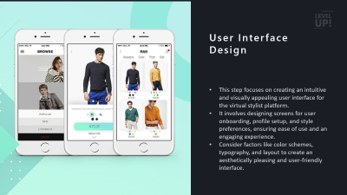
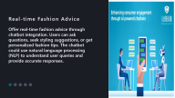
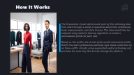
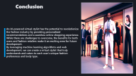
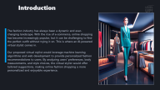
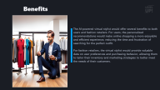
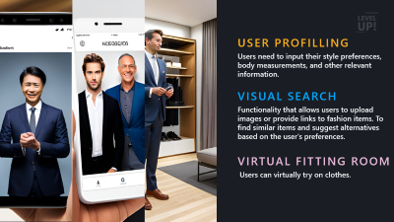
Unlock your fashion potential: Get personalized recommendations from our AI-powered virtual stylist.
Detailed View
PICTURE AND TEXT

Slide 4
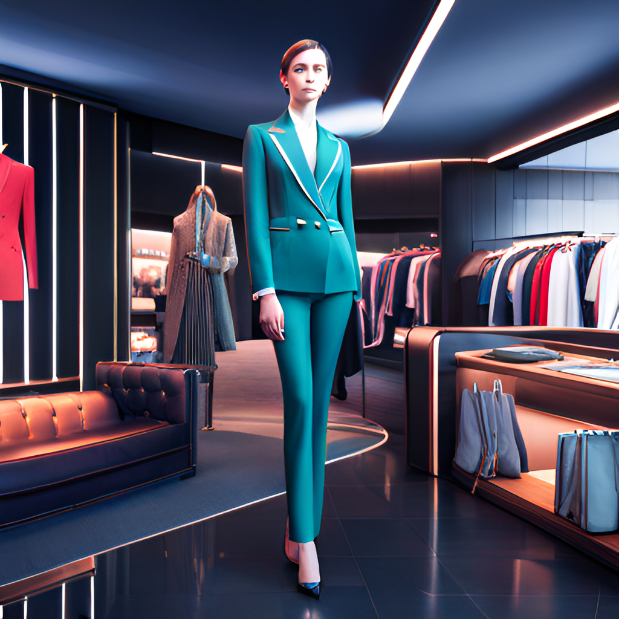
Introduction
The fashion industry has always been a dynamic and ever-changing landscape. With the rise of e-commerce, online shopping has become increasingly popular, but it can be challenging to find the perfect outfit without trying it on. This is where an AI-powered virtual stylist comes in.
Our proposed virtual stylist would leverage machine learning algorithms and web development to provide personalized fashion recommendations to users. By analyzing users' preferences, body measurements, and style choices, the virtual stylist would offer tailored suggestions, making online fashion shopping a more personalized and enjoyable experience.

Slide 5
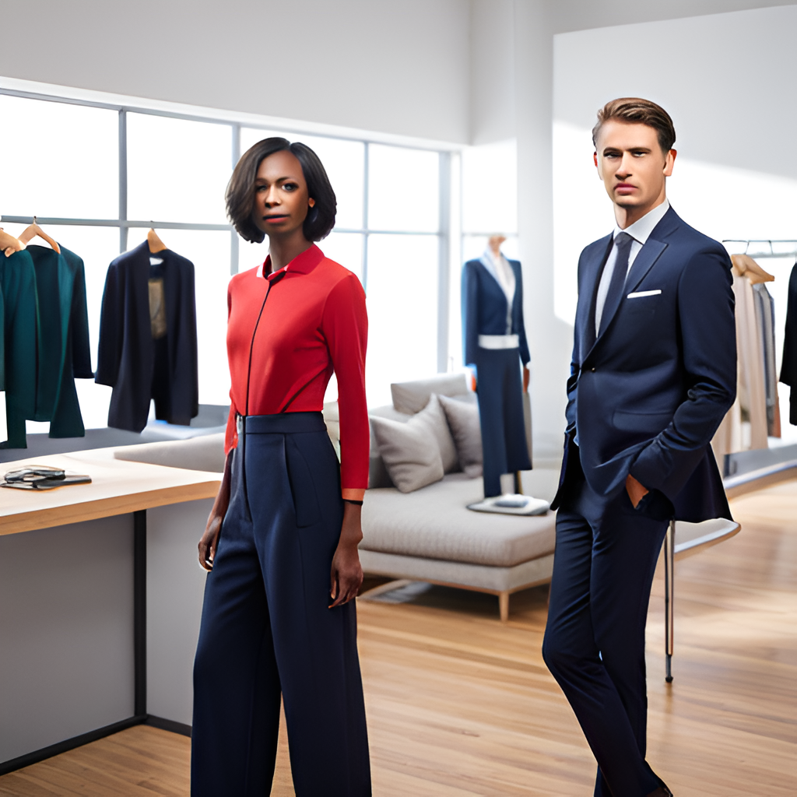
How It Works
The AI-powered virtual stylist would work by first collecting data from users through a series of questions about their preferences, body measurements, and style choices. This data would then be analyzed using machine learning algorithms to create a personalized profile for each user.
Based on this profile, the virtual stylist would recommend outfits that fit the user's preferences and body type. Users could then try on these outfits virtually using augmented reality technology and purchase the ones they like directly through the platform.

Slide 6
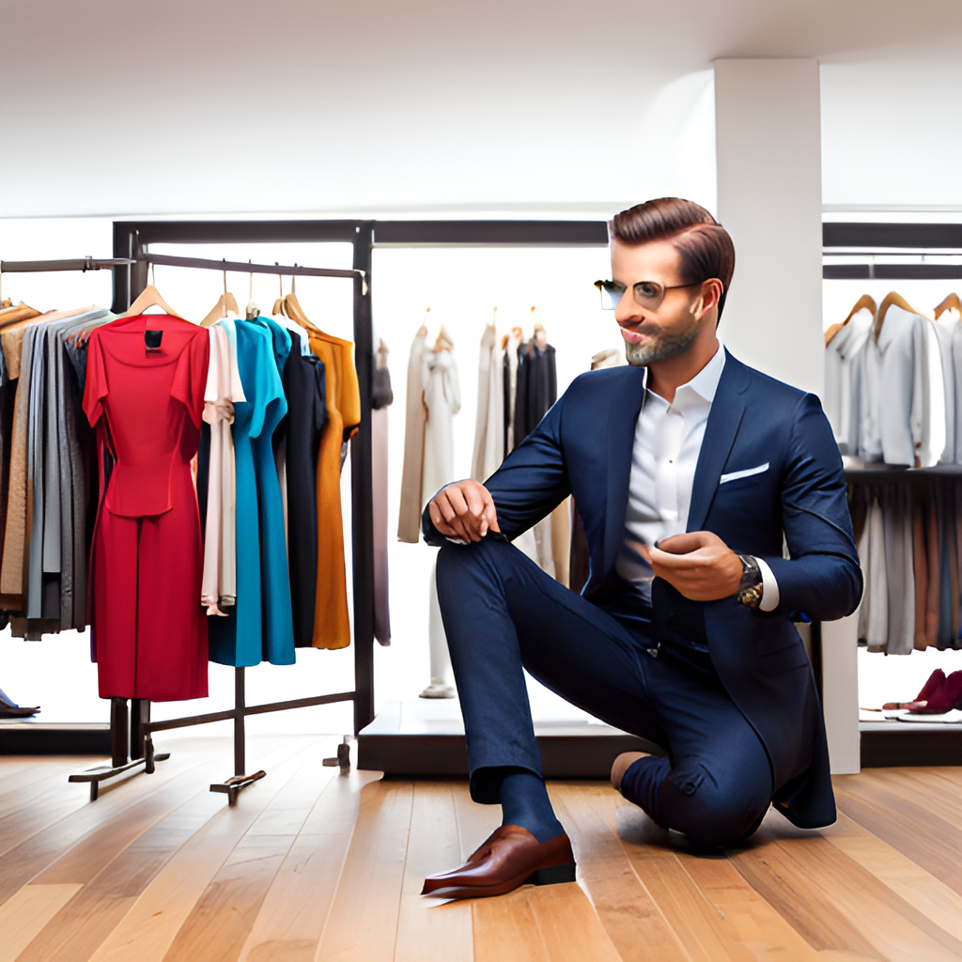
Benefits
The AI-powered virtual stylist would offer several benefits to both users and fashion retailers. For users, the personalized recommendations would make online shopping a more enjoyable and efficient experience, reducing the time and frustration of searching for the perfect outfit.
For fashion retailers, the virtual stylist would provide valuable data on user preferences and purchasing behavior, allowing them to tailor their inventory and marketing strategies to better meet the needs of their customers.

Slide 7
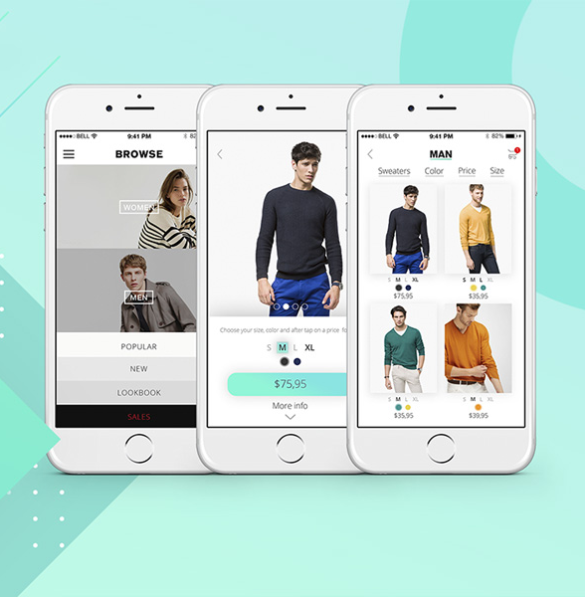
User Interface Design
This step focuses on creating an intuitive and visually appealing user interface for the virtual stylist platform.
It involves designing screens for user onboarding, profile setup, and style preferences, ensuring ease of use and an engaging experience.
Consider factors like color schemes, typography, and layout to create an aesthetically pleasing and user-friendly interface.

Slide 8
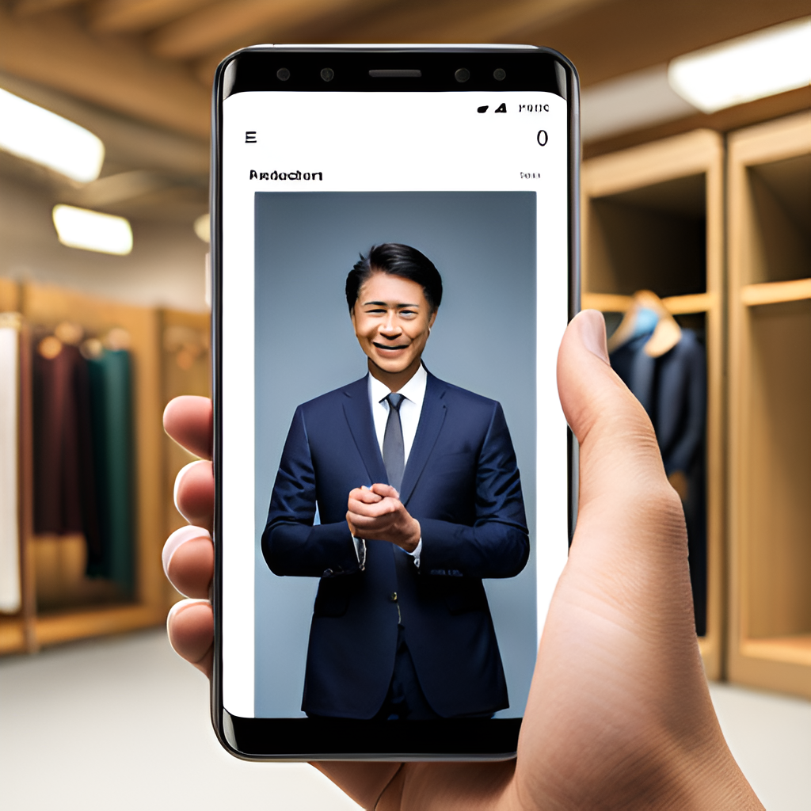
USER PROFILLING
In this step, we develop a process for users to input their style preferences, body measurements, and other relevant information.
This can be achieved through forms or questionnaires. The collected data serves as the foundation for generating personalized recommendations.
Consider the information that is most relevant for providing accurate and tailored fashion suggestions.

Slide 9
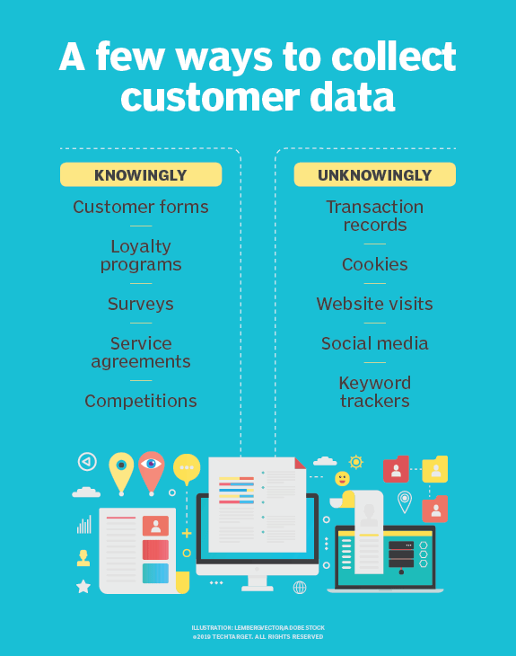
Data Collection And Preparation
This step involves gathering fashion-related data, including images, product descriptions, and user feedback.
Collect data from various sources like fashion catalogs, online retailers, or fashion influencers.
Ensure the data is clean, consistent, and ready for analysis. Data preprocessing techniques may include data cleaning, normalization, and feature extraction.

Slide 10
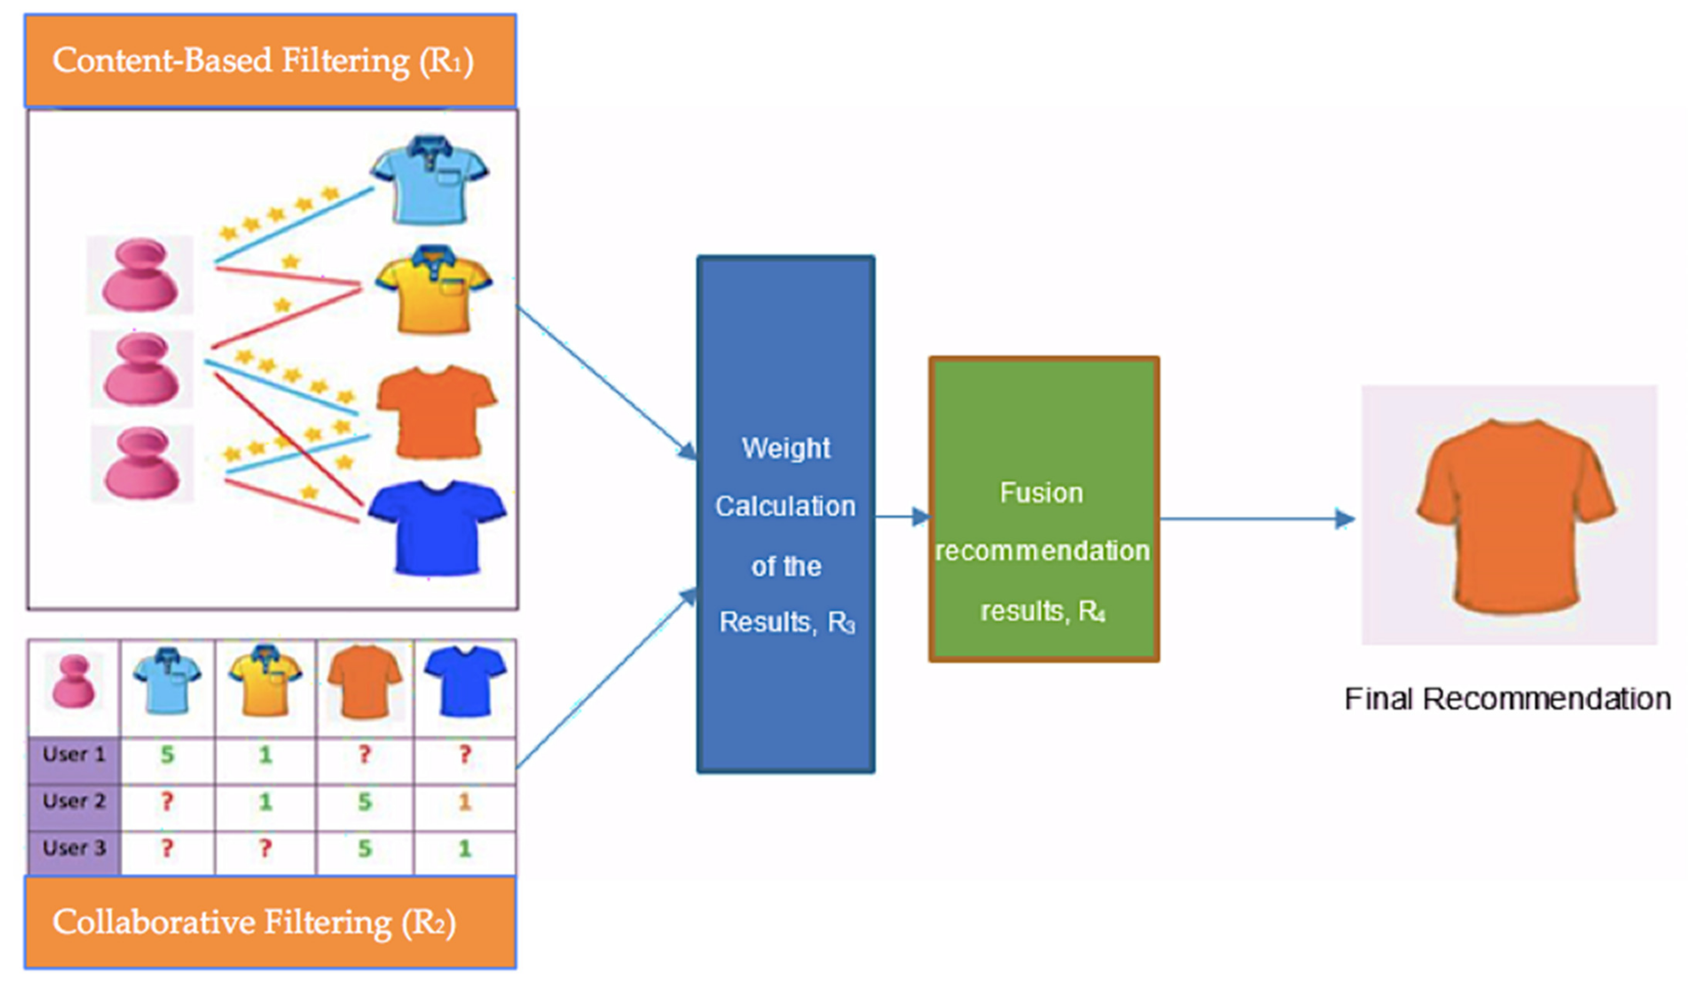
Machine Learning Model Development
Here, We develop machine learning models that can analyze user data and generate personalized fashion recommendations.
Explore recommendation algorithms such as collaborative filtering, content-based filtering, or hybrid approaches.
Train the models using the collected data, considering factors like user preferences, past purchases, browsing behavior, and feedback to provide accurate and relevant suggestions.

Slide 11
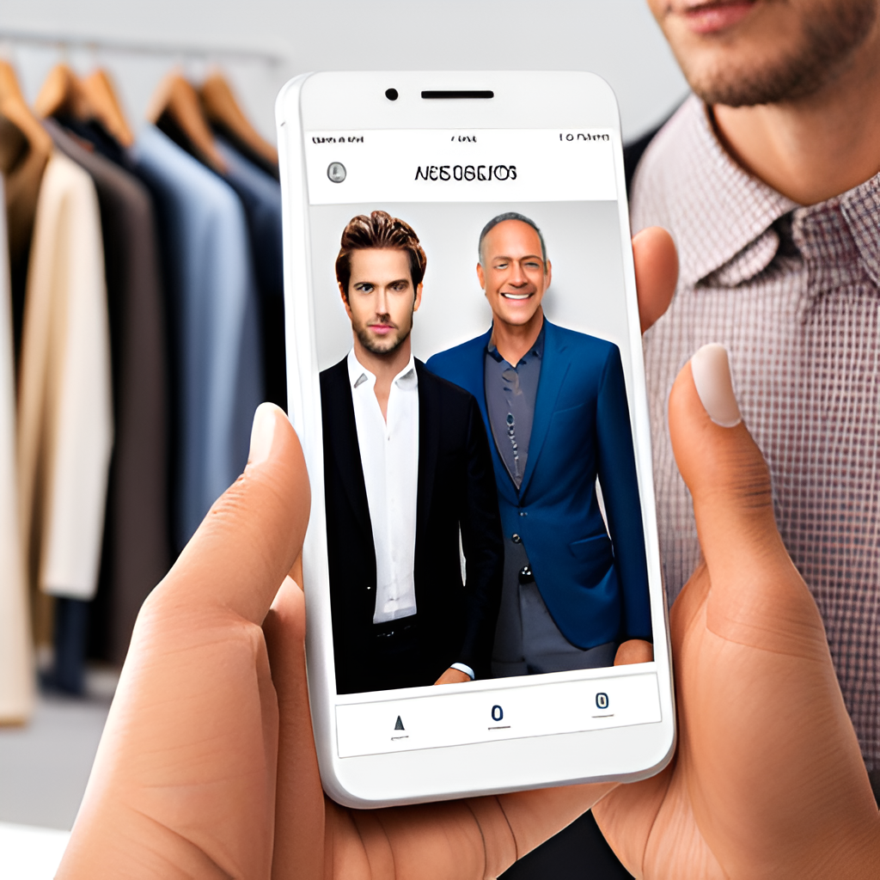
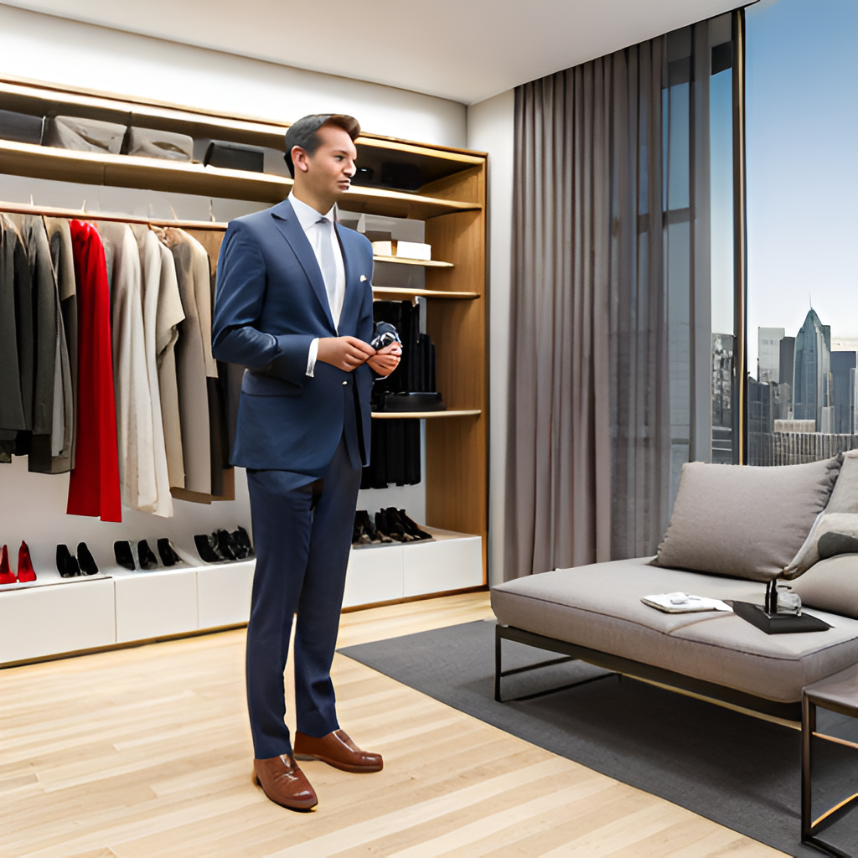
MACHINE LEARNING
MODEL
We develop machine learning models that can analyze user data and generate personalized fashion recommendations.
VISUAL SEARCH
Functionality that allows users to upload images or provide links to fashion items. To find similar items and suggest alternatives based on the user's preferences.
VIRTUAL FITTING ROOM
Users can virtually try on clothes.

Slide 12
Source: pexels.com
VISUAL SEARCH AND RECOMMENDATION ENGINE
Implement a visual search functionality that allows users to upload images or provide links to fashion items they like. The system will use computer vision and recommendation algorithms to find similar items and suggest alternatives based on the user's preferences.

Slide 13
VIRTUAL FITTING ROOM
Develop a virtual fitting room feature where users can virtually try on clothes. This could be achieved using augmented reality (AR) technology or by creating a 3D model of the user based on their body measurements. Users can see how different garments look on them without physically trying them on.

Slide 14


23%
Real-time Fashion Advice
Offer real-time fashion advice through chatbot integration. Users can ask questions, seek styling suggestions, or get personalized fashion tips. The chatbot could use natural language processing (NLP) to understand user queries and provide accurate responses.

Slide 15
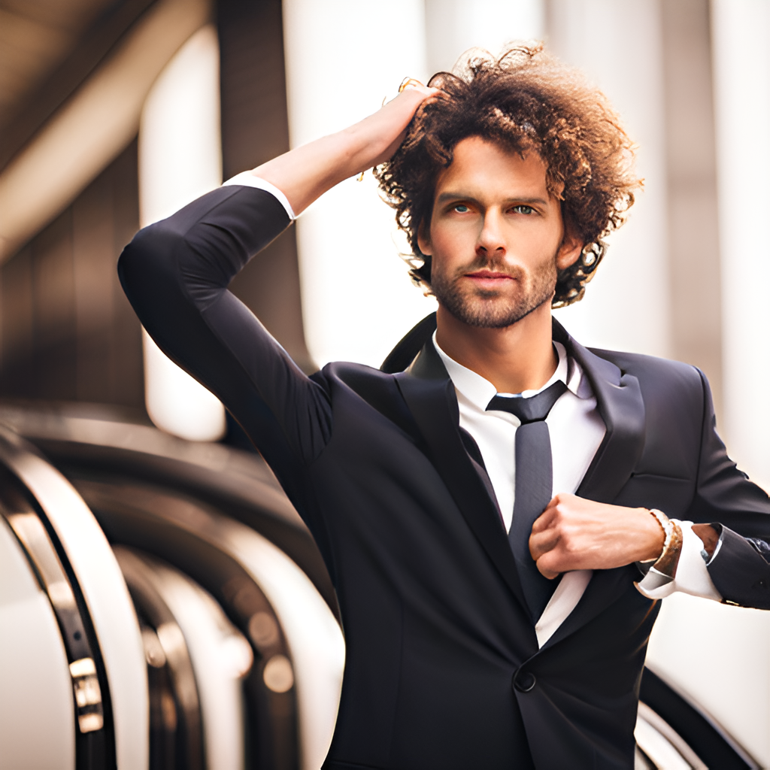
75%
E-Commerce Integration
Integrate the virtual stylist with e-commerce platforms, partnering with fashion retailers to showcase their products. Users can seamlessly click through to the retailer's website to make purchases.
Source: pexels.com

Slide 16


75%
User Feedback And Reinforcement
Implement mechanisms for users to provide feedback on recommended items. This feedback loop will continuously improve the accuracy and relevance of the virtual stylist's recommendations.

Slide 17

Challenges
While an AI-powered virtual stylist offers many benefits, there are also several challenges that must be addressed. One challenge is ensuring the accuracy of the machine learning algorithms used to analyze user data and make recommendations.
Another challenge is creating a seamless user experience that integrates virtual try-on technology with online shopping platforms. Finally, privacy concerns must also be addressed, as users will be sharing personal information with the virtual stylist platform.

Slide 18
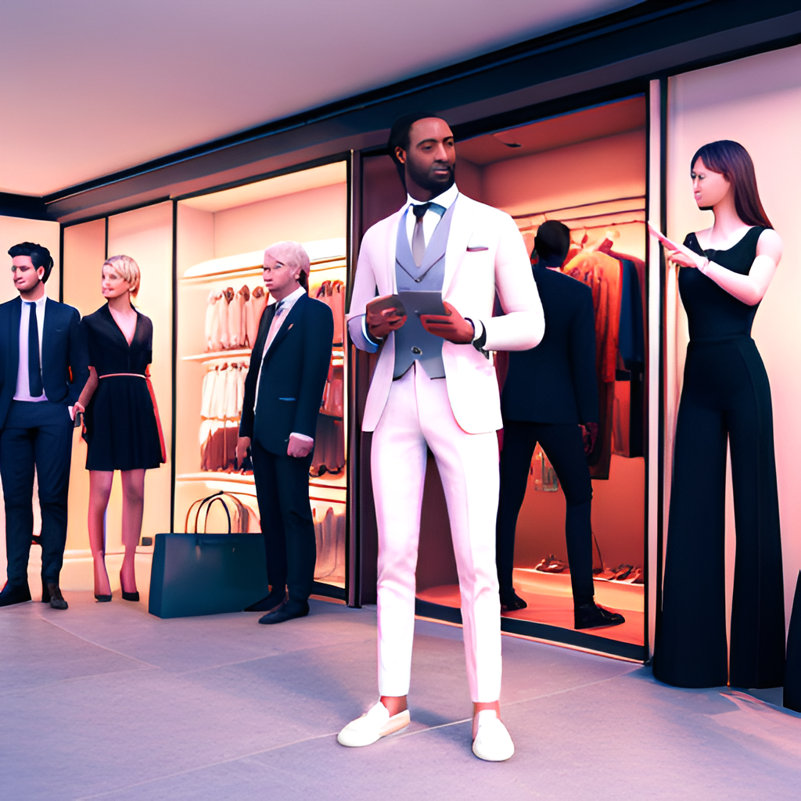
Conclusion
An AI-powered virtual stylist has the potential to revolutionize the fashion industry by providing personalized recommendations and a seamless online shopping experience. While there are challenges to overcome, the benefits for both users and fashion retailers make it an exciting area for future development.
By leveraging machine learning algorithms and web development, we can create a virtual stylist that truly understands and caters to each user's unique fashion preferences and body type.

Slide 19
Thankyou

